Slide 1
TripLine
by R. Buchyn and O. Vyshnevskyy

Slide 2
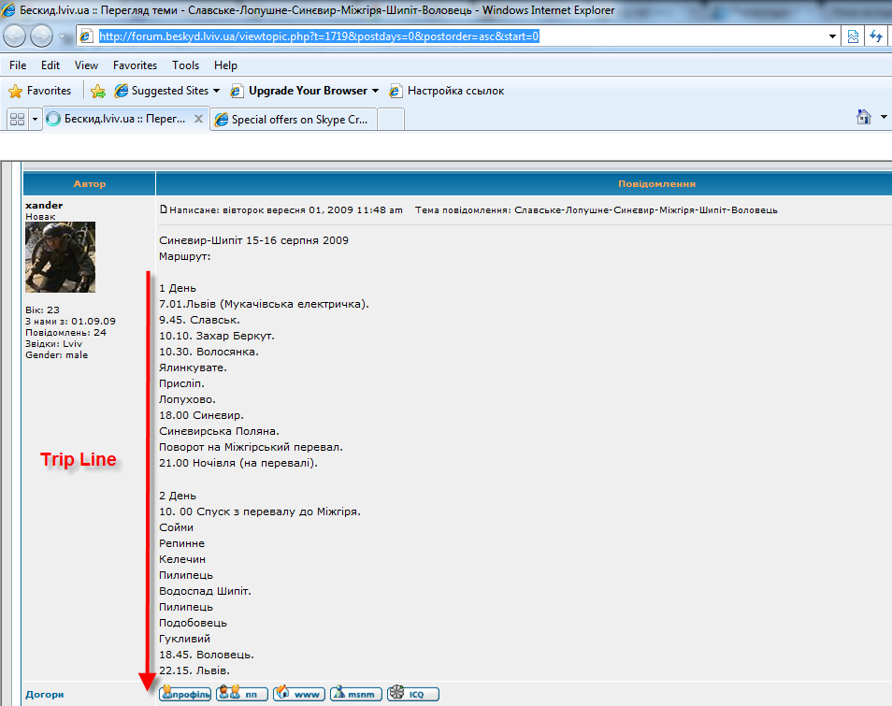
Problem

Slide 3
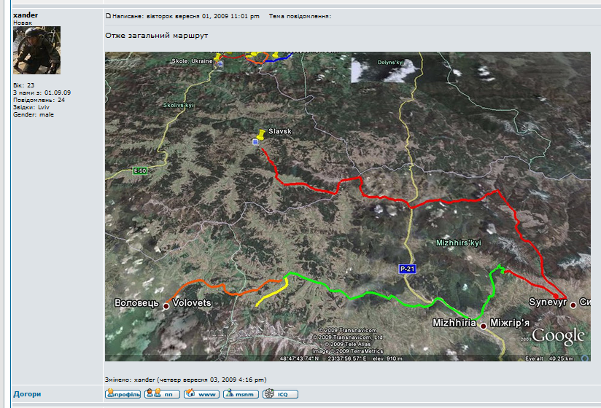
Problem

Slide 4
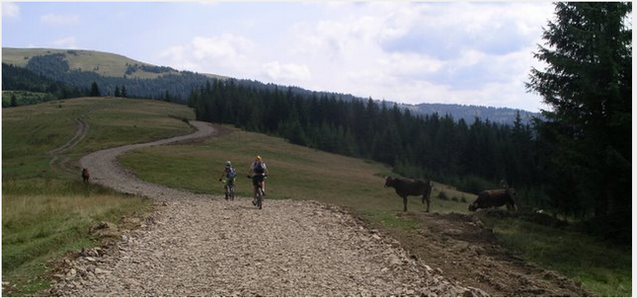
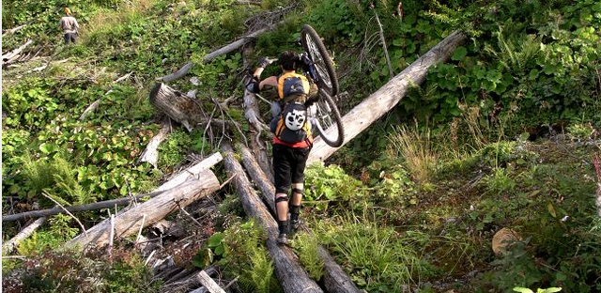
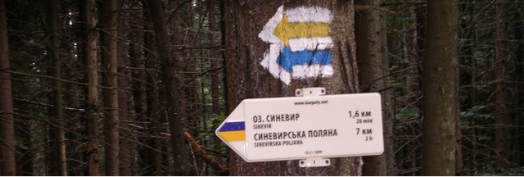
Problem

Slide 5
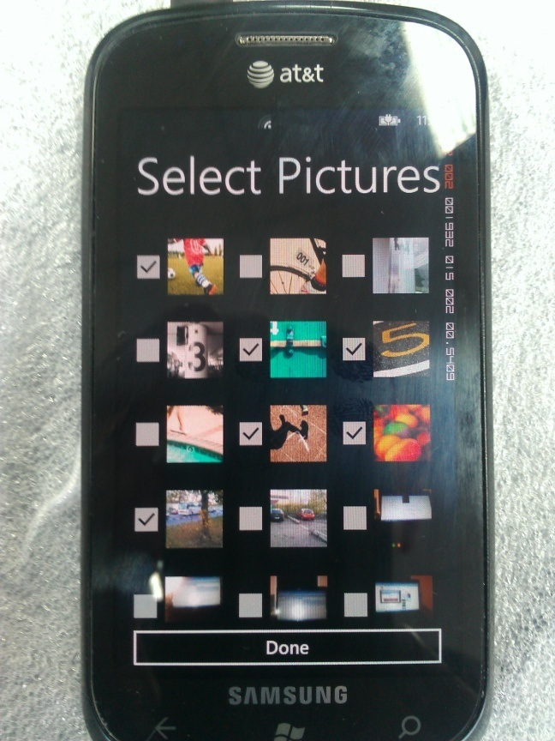

Slide 6
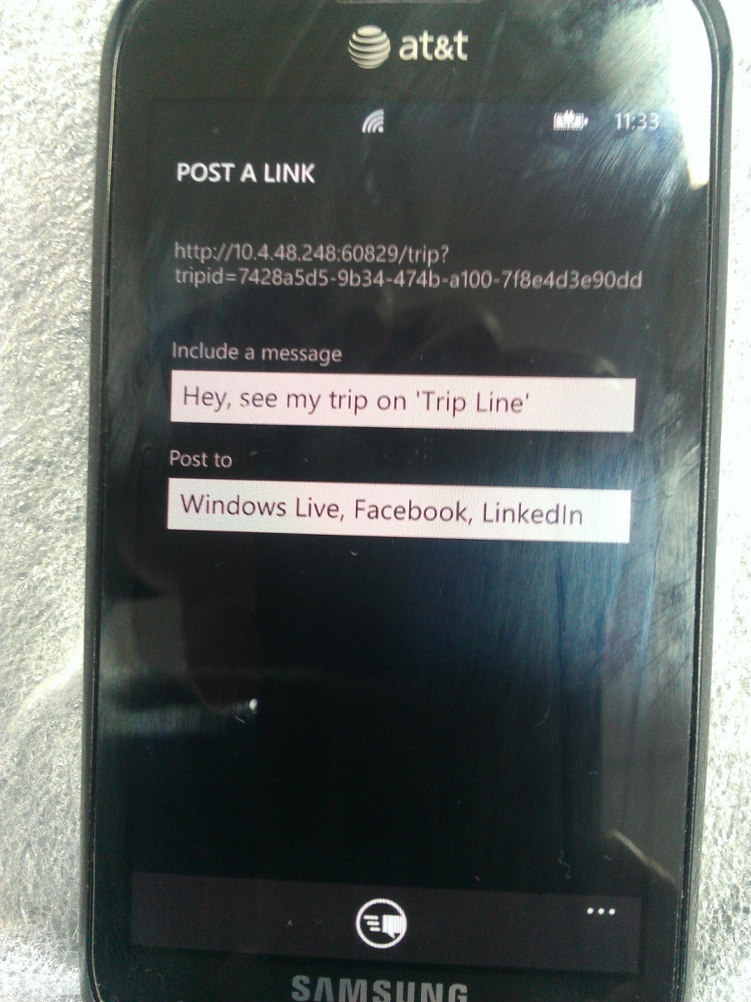

Slide 7
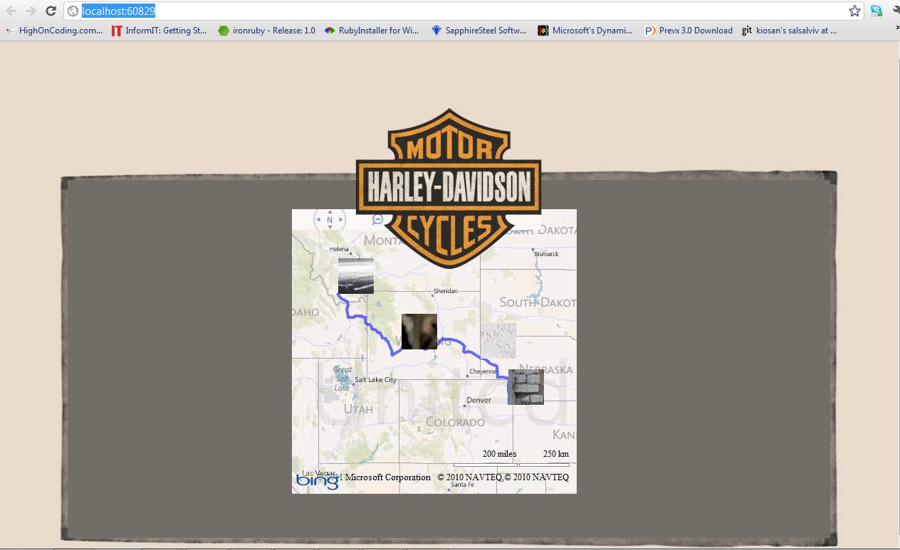

Slide 8


Slide 9
Issues
- Custom file extensions
- Multiple pictures selection
- Getting location from Image
- Windows Phone throw InvalidOperationException on PhotoChooserTask when connected with PC

Slide 10
Thank you

